Slide 1
Tore Alden Principal Analyst The Jacobsen
North America and Global Supply and Demand Trends
Notes:
Journey of transformation
Introductions to co presenters
Housekeeping & phones

Slide 2
The Jacobsen expects eight renewable diesel plants to begin production or expand capacity in 2022. There are five other plants that have announced they will begin production in 2022, but The Jacobsen believes they have less than a 50 percent chance of opening.
The expansion will raise annual renewable diesel capacity from an estimated 835 million gallons per year at the end of 2021 to 2.62 billion gallons by the end of 2022.
The Jacobsen changed its forecasting of capacity and feedstock usage to include the probability of plants opening. As a result, there is some slight downside risk to both predictions.
Fastmarkets | Agricultural Forecasting

Slide 3
The Jacobsen predicts feedstock demand for renewable diesel production will nearly triple in 2022 from about 625 million pounds per month to 1.75 billion.
Despite the record high HOBO spread, the expansion of production capacity has resulted in record domestic renewable diesel production in June and July.
The relative growth of fats and greases in the feedstock mix is due to a reduction in The Jacobsen’s biodiesel production forecast.
Despite record prices, The Jacobsen believes soybean oil will remain the most commonly used feedstock, accounting for about three quarters of the feedstock mix.
Fastmarkets | Agricultural Forecasting

Slide 4
The growth in renewable diesel capacity could force a substantial shift in refined soybean oil usage from edible use to inedible usage.
There remains significant questions about when, or if, non-biodiesel usage will decline. In 2020/21, The Jacobsen has steadily raised its forecast of non-biodiesel usage, creating a significant risk for its 2021/22 balance sheet projections.
Refined imports could surge if renewable diesel facilities on the West Coast import from Argentina.
Fastmarkets | Agricultural Forecasting

Slide 5
The lack of refining capacity relative to growing demand drove the spread between crude soybean oil and RBD to record levels in 2021.
Crushers have announced expansions in crushing and refining capacity, but there is unlikely to be any significant change until the fall of 2022.
The Jacobsen believes renewable diesel plants could add up to 5.6 billion pounds of refining capacity as they open, which could help narrow the spread between crude and RBD.
Fastmarkets | Agricultural Forecasting

Slide 6
The spread between soybean oil and heating oil futures (HOBO) rose to a record high above $3.40 per gallon in June. The move drove soybean oil profitability to a record low. As a result, soybean oil usage in renewable diesel production fell sharply.
Since then, the spread has fallen, and soybean oil profitability has improved and now it is the third most profitable feedstock.
The Jacobsen expects the improvement in profitability to increase soybean oil usage in the coming months.
Fastmarkets | Agricultural Forecasting

Slide 7
The profitability of soybean oil has improved in biodiesel production but remains near the lower end of the feedstock mix.
Despite its relative profitability, The Jacobsen still expects the improvement over the last six weeks to increase demand during the fourth quarter of 2021.
Canola oil remains unprofitable in biodiesel production, but it has improved since early May. However, The Jacobsen believes the improvement in profitability could modestly increase demand in the fourth quarter.
Fastmarkets | Agricultural Forecasting

Slide 8
The Jacobsen believes the U.S. could become a net importer of soybean oil in 2021/22. However, much of this increase will depend on South American production.
One of the biggest questions for analysts projecting soybean oil balance sheets is the level of non-biofuel use. The Jacobsen predicts non-biofuel demand will fall by more than three billion pounds in 2021/22, but an expected decline in 2020/21 has not materialized despite historically high prices. Non-biofuel use in 2019/20 suggests the floor for usage could be around 13 billion pounds.
There is downside risk to The Jacobsen’s biofuel usage projection. However, any reduction in biofuel use will raise its prediction of non-biofuel usage. As a result, its ending stocks forecast also has some downside risk.
Fastmarkets | Agricultural Forecasting

Slide 9
Despite its expectation for weakness in non-biofuel usage for soybean oil, The Jacobsen expects consumer spending on food to remain robust through the end of the year.
The relatively strong projections for food away from home are driven by robust demand and weak year-over-year comparisons.
Similarly, the weak projections for food at home are due a relatively strong baseline for the year-over-year comparisons.
Fastmarkets | Agricultural Forecasting

Slide 10
Non-biofuel usage has been stronger than expected in 2020/21 despite record prices. The Jacobsen’s forecast of soybean oil non-biodiesel use in 2020/21 has steadily risen from 11 billion pounds early in the marketing year to 14.5 billion, 250 million below USDA’s August projection.
The growth in non-biodiesel usage will likely drive U.S. per capita usage to a record 21.2 pounds in 2020/21, above the prior record of 21.1 in 2015/16.
The Jacobsen still expects canola oil to account for a growing share of non-biofuel usage. However, short crops in the U.S. and Canada will likely drive prices sharply higher, driving potential downside risk to its expectation.
Fastmarkets | Agricultural Forecasting

Slide 11
The profitability of soybean oil as a feedstock for biodiesel has been steadier than renewable diesel. However, the recent recovery in profitability has favored renewable diesel.
The drop in soybean oil profitability in biodiesel production in May and June resulted in a sharp decline in soybean oil usage in biodiesel production. The Jacobsen estimates soybean oil usage in biodiesel production fell to 579 million pounds in May, down 226 million pounds from 805 million in 2020.
Fastmarkets | Agricultural Forecasting

Slide 12
The Jacobsen believes soybean oil usage in renewable fuel production will remain below last year through the end of 2020/21 due to record price levels.
The sharp increase it expects for soybean oil usage in 2021/22 is due to the growth in renewable diesel capacity and limited availability of alternative feedstocks.
The strength in use early in the marketing year was due to lower prices and a reduction in fats and greases supplies due to the measures put in place to slow the pandemic.
Fastmarkets | Agricultural Forecasting

Slide 13
The sharp increase in soybean oil prices has slowed U.S. soybean oil export sales dramatically in 2021. The slowdown suggests 2021/22 exports could fall to the lowest level since 2003/04.
Despite the outlook, South American production remains a significant risk to the expectation that the U.S. could become a net importer of soybean oil.
Fastmarkets | Agricultural Forecasting

Slide 14
Brazilian crush has been running at about the same volume as last year. However, The Jacobsen expects crush to rise by a little more than two percent. If crush falls short of expectations, Brazilian exports could be weaker than expected.
A shift in the Brazilian government’s biodiesel mandate lowered The Jacobsen’s expectation for 2021/22 soybean oil in biodiesel production. If the ten percent blend rate remains in place, The Jacobsen’s 2022/23 biodiesel usage forecast will be reduced, allowing for larger exports.
Fastmarkets | Agricultural Forecasting

Slide 15
Argentine crush has risen by about 11 percent during the first quarter of 2021/22. However, problems with water levels at the Upriver ports has added costs to exports narrowing the spread to the U.S. Gulf from more than 13 cents per pound earlier in the month to about four cents.
The recent change in Argentine blend rates and the limited availability of export markets will likely reduce biodiesel production further in 2022/23. However, the additional supply will be absorbed by the export market.
Fastmarkets | Agricultural Forecasting

Slide 16
The cuts in U.S. shipments will increase the opportunities for Argentine shipments to Western Hemisphere countries.
Structural deficits in India and China raise the concentration of shipments to the top six countries.
If the U.S. becomes a major importer of soybean oil, developing countries will increasingly need to switch to palm oil.
Fastmarkets | Agricultural Forecasting

Slide 17
Hot and dry conditions in the northern Plains cut U.S. canola production by more than 450 million pounds to the lowest level since 2015/16.
The Jacobsen’s forecast assumes a modest drop in imports from Canada, but the sharp reduction in Canadian production could reduce the supply available for crushing.
There is downside risk to the canola oil usage in biodiesel production forecast due to the expectation for rising canola oil prices. However, the approval of an EPA pathway for renewable diesel could offset some of the decline in biodiesel demand.
Fastmarkets | Agricultural Forecasting

Slide 18
The reduction in U.S. and Canadian crops will reduce supplies, but not as much as the decrease in crops would suggest.
The Jacobsen expects rising U.S. imports from Australia to offset a small portion of the decline in imports from Canada.
Rising biofuel demand and the need to backfill non-biofuel demand from other feedstocks could drive U.S. canola oil prices to record highs.
Fastmarkets | Agricultural Forecasting

Slide 19
Despite record prices, The Jacobsen expects Canadian domestic usage to remain relatively stable in 2021/22.
If crush is below The Jacobsen’s expectations, it will likely cut its export forecast further and reduce its projection of U.S. imports.
Biofuel demand is expected to account for about ten percent of domestic usage.
Fastmarkets | Agricultural Forecasting

Slide 20
The Jacobsen expects Statistics Canada to report Canadian canola production dropped about four million tonnes to 14.75 million in 2021, 1.25 million below USDA’s August assessment.
Record canola prices could lead to a larger increase in acreage in 2022, despite the larger taxes. However, it is more likely farmers will switch wheat acreage to canola. In 2021, Canadian farmers planted 23.3 million hectares of wheat and 22.5 million hectares of canola. Both totals were below recent peaks due to a recent increase in fuel taxes costing a 5000-acre farm between C$8,000 and C$10,000 per year.
Fastmarkets | Agricultural Forecasting

Slide 21
If the crop is smaller than The Jacobsen’s forecast, it will continue to favor reductions in exports over further cuts in its crushing volume prediction.
The Jacobsen expects the sharp reduction in crop size and tight carryin to cut crush by 810,000 tonnes to 9.6 million from 10.4 in 2020/21. The Jacobsen predicts exports will decline by nearly 50 percent to 5.35 million, 1.55 million below USDA’s August prediction of 6.9 million.
Fastmarkets | Agricultural Forecasting

Slide 22
The decline in feedstock demand is due to falling export demand due to the increase in production in the U.S., by far the largest market for Canadian biodiesel.
The rising cost of vegetable oils slowed demand in mid-2021 with usage in renewable fuel production in May dropping 25 percent from 2020.
Renewable fuel production during the April and May rose sharply from 2020, with producers shifting to fats and greases for feedstocks due to the high cost of vegetable oils.
Fastmarkets | Agricultural Forecasting

Slide 23
Renewable diesel production in Canada remains marginal. While soybean oil has been the majority of the feedstock mix, an expansion in capacity will focus on municipal waste. However, capacity could expand to about 23.5 million gallons per year by the end of 2023.
The expansion includes a 7.5 million gallon per year plant in Ontario that could raise the demand for vegetable oil.
Fastmarkets | Agricultural Forecasting

Slide 24
Despite political tensions, China remains one of the largest destinations for Canadian canola oil. The shortfall in domestic vegetable oil production relative to the growth of domestic demand means Chinese buyers will need to replace the reduction in canola oil imports from Canada.
Due to the relatively small size of the other destinations, any change in Canadian exports will impact shipments to the U.S. and China.
The Australian crop is reported to be in good condition, but shipping costs make canola oil from Australia less competitive in the U.S. and political tensions with China could also limit the potential for an increase in canola shipments.
Fastmarkets | Agricultural Forecasting

Slide 25
The Jacobsen expects soybean oil prices to generally trade within a range between 60 and 65 cents over the next year.
The next opportunity for a substantial break in soybean oil prices will be when the market prices in the size of South American production.
If South American production falls short of 2021 levels, soybean oil prices could retest the recent highs.
Fastmarkets | Agricultural Forecasting

Slide 26
The Jacobsen believes the shortfall in U.S. and Canadian production will support canola oil prices over the next 12 months and could drive prices above $1.25 per pound.
The most significant downside risk to The Jacobsen’s price outlook is the 2021 and 2022 RFS mandates. If the Biden administration keeps 2022 obligations below 2020, vegetable oil prices could fall below the lower end of The Jacobsen’s predictions.
Fastmarkets | Agricultural Forecasting

Slide 27
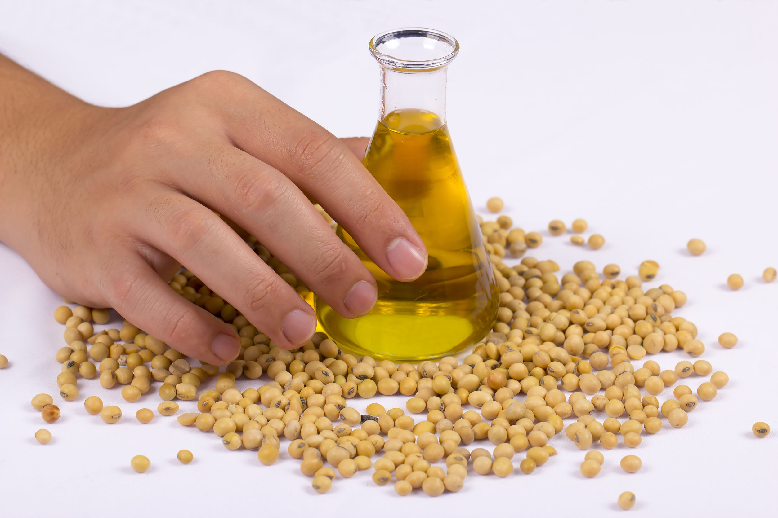

Questions?
Fastmarkets | Agricultural Forecasting

